Slide 1
Cleantech : Transforming Waste Management With Transfer Learning
SlideMake.com

Slide 2
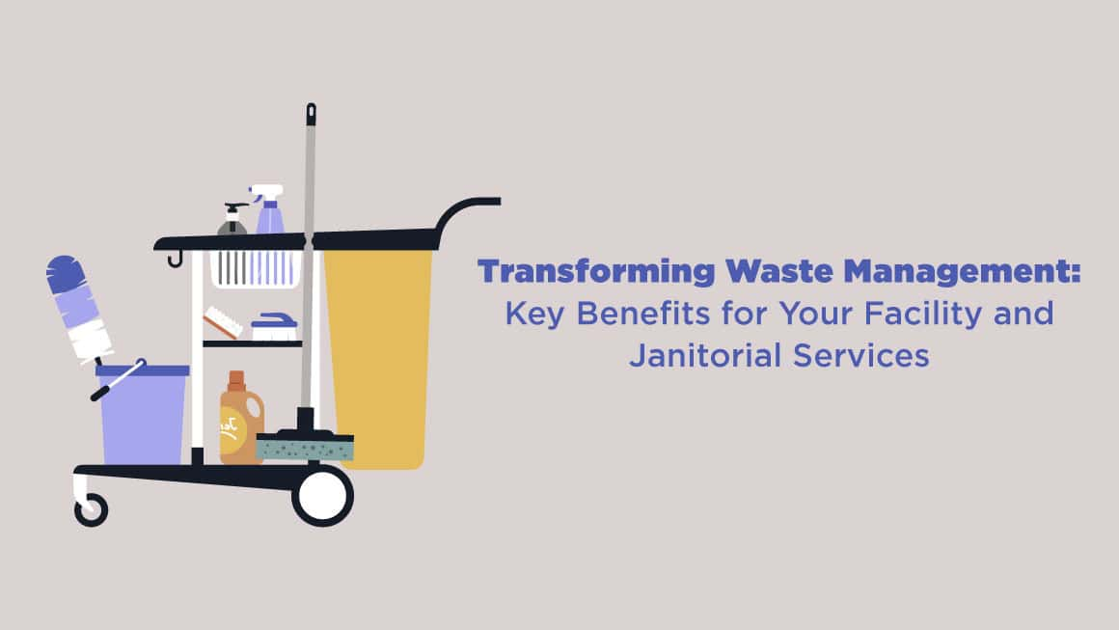
Introduction to Cleantech and Waste Management
Cleantech focuses on innovative solutions to reduce environmental impacts and improve sustainability.
Waste management is a critical area where technology can significantly enhance recycling, reduction, and reuse efforts.
Transfer learning offers promising opportunities to advance waste management systems through AI and machine learning techniques.
Notes:
Image source: https://www.buschsystems.com

Slide 3
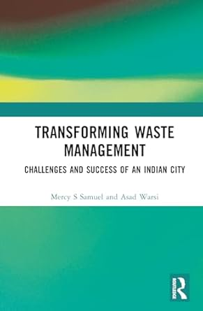
Challenges in Traditional Waste Management
Manual sorting and classification of waste are labor-intensive and prone to errors.
Inconsistent waste data and limited labeled datasets hinder effective automation.
Current systems often lack adaptability to varying waste streams and changing waste compositions.
Notes:
Image source: https://m.media-amazon.com

Slide 4

What is Transfer Learning?
Transfer learning involves leveraging pre-trained models on large datasets to improve performance on related tasks with limited data.
It enables models to transfer knowledge from one domain to another, reducing training time and resource requirements.
This approach is especially useful in fields like waste management, where labeled data can be scarce.
Notes:
Image source: https://dataaspirant.com

Slide 5
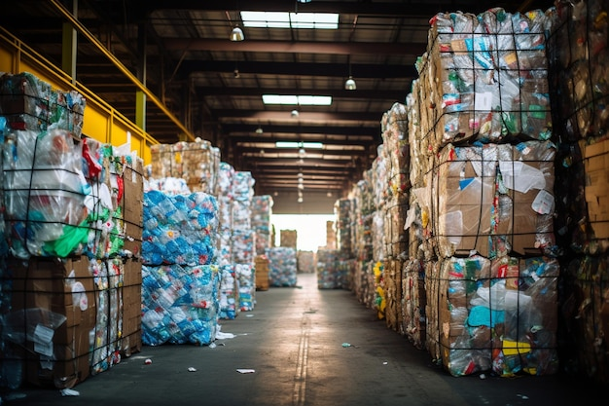
Application of Transfer Learning in Waste Sorting
Transfer learning models can accurately classify different types of waste materials such as plastics, metals, and organics.
Pre-trained convolutional neural networks (CNNs) can be fine-tuned to recognize waste categories with minimal additional training.
This improves sorting efficiency and reduces contamination in recycling streams.
Notes:
Image source: https://img.freepik.com

Slide 6

Enhancing Waste Monitoring and Tracking
Transfer learning can facilitate real-time waste monitoring through image and sensor data analysis.
Models can be adapted to identify illegal dumping and optimize collection routes dynamically.
These capabilities lead to more effective waste management and environmental compliance.
Notes:
Image source: https://www.slidemake.com

Slide 7
Benefits of Using Transfer Learning in Cleantech
Reduced need for large, labeled datasets accelerates deployment of AI solutions.
Improved accuracy and robustness of waste classification systems enhance recycling quality.
Scalability and adaptability of models allow for deployment across diverse waste management facilities.
Notes:
Image source: https://www.buschsystems.com

Slide 8
Case Studies and Real-World Examples
Several waste management companies have successfully applied transfer learning to automate sorting processes.
Pilot projects demonstrate increased recycling rates and cost savings through AI-driven waste classification.
Governments are adopting these technologies to modernize urban waste management infrastructure.
Notes:
Image source: https://www.slidemake.com

Slide 9
Challenges and Limitations
Transfer learning models may require domain-specific fine-tuning to achieve optimal performance.
Variability in waste appearance and environmental conditions can affect model accuracy.
Ensuring data privacy and addressing ethical concerns remain important considerations.
Notes:
Image source: https://m.media-amazon.com

Slide 10
Future Directions in Cleantech and Transfer Learning
Integration of transfer learning with IoT sensors for comprehensive waste management solutions.
Development of more generalized models capable of handling multiple waste categories and scenarios.
Collaboration between technologists, policymakers, and industry stakeholders to scale successful implementations.
Notes:
Image source: https://media.caboodleai.net

Slide 11
Conclusion and Outlook
Transfer learning has the potential to revolutionize waste management by enabling smarter, faster, and more accurate systems.
Continued research and investment are essential to overcome current challenges and expand adoption.
Embracing these technologies will contribute significantly to sustainable waste management and environmental preservation.
Notes:
Image source: https://www.buschsystems.com

Slide 12
References
[Include relevant articles, papers, and sources related to cleantech, transfer learning, and waste management here.]
Your second bullet
Your third bullet

